Slide 1

FYP Proposal defense
Sensor Integrated Microphysiological System for Real Time and Online Monitoring
Group member 1:
Wakeel Ahmed (033-19-0026)
Group member 2:
Muhammad Saqlain (033-20-0011)
Group member 2:
Faizan Ahmed (033-20-0032)
Supervisor:
Dr. Fida Hussain Memon
Co-supervisor: None

Slide 2

Outline
Introduction
Literature Review
Problem Statement
Objectives
Methodology
Block Diagram

Slide 3
Introduction
Microphysiological Systems (MPS) are advanced models that replicate human organ functions.
These systems are used for drug testing, disease modeling, and personalized medicine.
For recording of variable biological processes, real-time monitoring of MPS is required.

Slide 4
Diff: B/W Online & Realtime Monitoring
online systems allow users to interact with data stored in databases and are accessible from anywhere at any time
real-time systems are designed to process data in real time and must respond to events quickly and accurately.
https://www.geeksforgeeks.org/difference-between-online-and-real-time-systems/

Slide 5
Literature Review
Sensors attached to myRio and LabVIEW for capturing real time sensor data.
Though sensor data were obtained successfully. The system was unable to synchronize and acquire information for remote monitoring purposes.
Because of this, downloading sensor information via mobile app in a usable format such as CSV was not possible.

Slide 6
Literature Review
With these improvements, users would be able to access their sensor data from any place without problems.
To deal with the problems of data synchronization, firebase should be employed for its real-time database features.
The android app needs to be developed, which would enable easy download of sensor data in CSV format making it more applicable for clinical and research purposes.

Slide 7
Why Glucose?
Primary Energy Source: Glucose is the primary fuel that runs the body, and its levels control most processes in the body.
Diabetes Indicator: High glucose levels are associated with diabetes, a significant health issue worldwide. Regular monitoring helps diagnose and manage this disease effectively.
Insulin(move glucose from our bloodstream into the body's cells to make energy) Effects: Abnormal glucose levels may sign problems in the production or functioning of insulin, often related to the pancreas or adrenal glands.
Other Conditions: High levels may show endocrine (Menopause, Diabetes, Addison's disease.) disorders; and low levels can be another symptom of liver disease or side effects from the medicines taken for diabetes.
Serious Health Consequences: Imbalances in glucose levels, could lead to life-threatening events, such as seizures or brain damage.
Versatile Testing Options: providing flexibility in diagnosis and monitoring.
https://medlineplus.gov/lab-tests/blood-glucose-test/#:~:text=What%20is%20it%20used%20for,help%20diagnose%20and%20monitor%20diabetes.

Slide 8
Problem Statement
Difficulties in Real-Time Data Acquisition & Accessibility:

Slide 9
Objectives
Online Sensor Data Monitoring: Implement a system for real-time monitoring and remote access to sensor data.
Real-Time Monitoring for Continuous Experimental Phase: Develop a framework for real-time data acquisition and visualization from sensors.
Sensor Data Logging for Drug Proposing: Create a data logging system that captures and stores sensor data in CSV files, providing a reliable dataset for drug proposal and development analysis.

Slide 10
Objectives
Wireless Monitoring Using Mobile App: Facilitate wireless monitoring and visualization of sensor data through a mobile application, allowing real-time data access.
Integration of System Using Network Protocols: Ensure secure data transmission from the sensors to an online database.

Slide 11
Methodology
System Configuration: Set up the myRio controller
Software Development: Utilize LabVIEW to analyze and visualize sensor data.
Configure Firebase for real-time data storage and retrieval.
Mobile Application Development: Develop an Android application that provides a user interface for real-time data access.

Slide 12
Methodology
Integration: Integrate micro physiological sensors with the myRio controller, LabVIEW software, Firebase database, and Android application.
Feedback Collection: Collect feedback from users to evaluate system performance and user satisfaction.
Optimization and Scaling: Analyze feedback and performance data to make necessary adjustments.

Slide 13
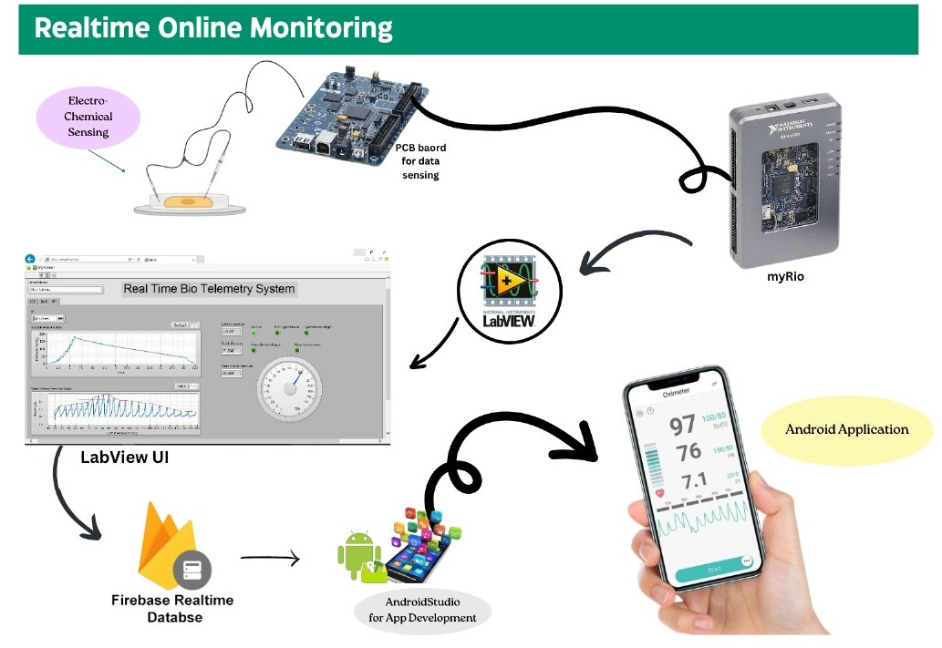
Block Diagram

Slide 14
Thank You!

Slide 15
References
AComprehensive Review of Biosensor Integration in Microphysiological Systems for Online Monitoring: Current Challenges and Future Advancements.
Monitoring of Microphysiological Systems: Integrating Sensors and Real-Time Data Analysis Toward Autonomous Decision Making

